Slide 1
Why is it important to press release your findings?

Slide 2








Highfield Primary School
Surrey Disability Action
Bronchiolitis Coalition
Notes:
22 years campaigns professional
Ministers, MPs, Councillors, Residents groups, football clubs, predominantly health related organisations
Changed laws, regulation, service specs, increased investment
Now at Tamba
Strategic priorities are to save lives – clinical research and improving practice
Support families – greater parental stress, twice the chance of pnd, living in or just above the poverty line

Slide 3

Notes:
Everyone here is a bit like this girl. There is a bit of super hero in all of us. Your work and what we do are agents of change.

Slide 4

Get your message out there
Patients
Carers
Clinical teams (duty of candour)
Policy makers
Journalists
Commissioners
Funders (public money)
Researchers
Notes:
The only way to change things for the better is to tell people about your work and what you found
There are a huge range of stakeholders that want to know what you find
You have a duty to tell them
The only way to reach a broad range of people is via the media

Slide 5
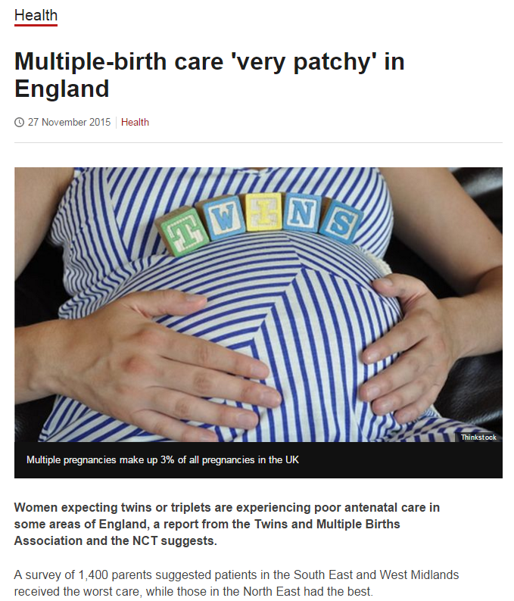
How to get coverage
Plan well in advance
Involve partners
Use your communications team or HQIP
Keep the message simple – repeat it
Don’t be a control freak
Target your audience
Target relevant outlets
Notes:
I’m not going to tell you how to write a press release, or how to sell in to the media, or how to talk to them.
There are professionals around you with this expertise that you should use and rely on
These are the most important points
A press release has most impact when brought to the attention of key officials/policy makers/commissioners/clinician teams

Slide 6
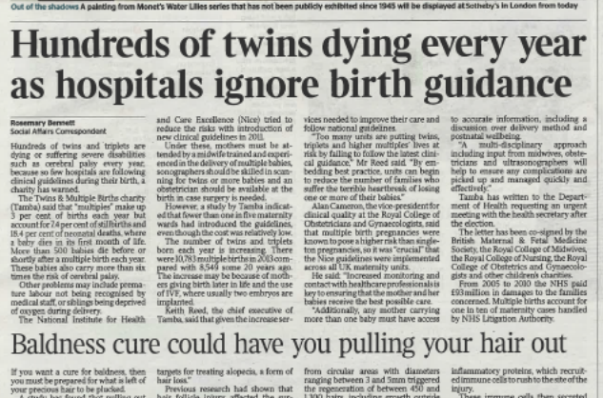
ONS Stillbirth Release
Signed up partners to a campaign prior to the release
Placed a story – the Times
Secured meeting with Minister & key policy formers
Agreements to change policies, commissioning documents & inspection frameworks
Notes:
This is an example of generating movement for change through issuing a press release and placing it in the media

Slide 7
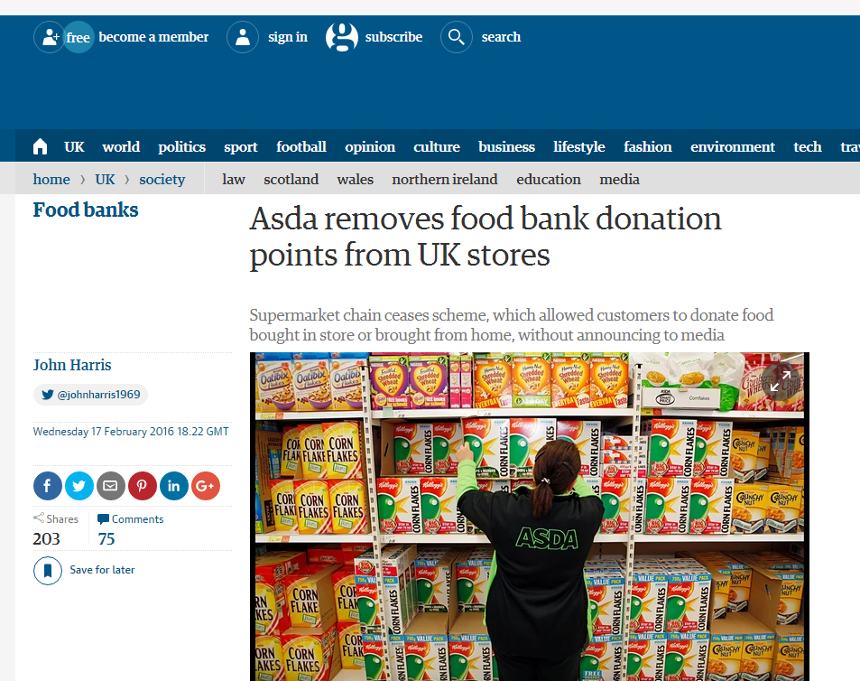
How it helps to effect change
It’s topical
There is evidence
Others agree
I am being asked to do something
Notes:
It’s amazing the impact media stories have on all of us
Even the most cynical or evidence based individuals is influenced by them
It’s simplistic but commonly this is the type of thought process that policy makers/politicians and others go through

Slide 8

Things we’ve learned
You are an agent of change
Use the communications team
Tell them and your partners what you are doing as early as possible
Identify and target your key audiences
Positive or Negative – keep the message simple
Repeat it

Slide 9

Notes:
Go on dive in and make change happen
Questions – what puts people off? What makes them nervous? Positive stories – negative stories – what’s best?

